Slide 1

Notes:
(Introduce yourself.)

Slide 2

Notes:
This presentation was created by NetSmartz Workshop, a program of the National Center for Missing & Exploited Children. The National Center:
Helps in the recovery of missing children.
Assists victims of sexual exploitation.
Educates communities about personal safety through programs like NetSmartz.
NetSmartz is a safety program that:
Teaches children ages 5 to 17 about how to make better choices online.
Guides parents in protecting their children online.
Offers a variety of free resources, including games, videos, classroom lessons and presentations like this one.
You can find all of these resources at NetSmartz.org.

Slide 3

Notes:
Throughout this presentation, we’re going to talk about ways you can protect your children online no matter where they access the Internet.
Kids go online from:
School computers.
Friends’ computers.
Laptops and tablets.
Cell phones.
MP3 players like the iPod Touch.
E-readers like the Nook and Kindle.
Game consoles like the Nintendo Wii U, PlayStation 3 or Xbox 360.
Handheld gaming devices like the Nintendo 3DS or the PlayStation Vita.
Technology changes all the time and kids are constantly finding the newest websites, apps and gadgets. It’s up to you to teach them the basic rules of Internet safety so that they can use all of these responsibly.

Slide 4

Notes:
So what are your kids currently interested in online?
(Pause for audience response. If you need to prompt the audience, use the questions below. Take note of their answers and tailor your presentation to their children’s current interests.)
How many of your children like to:
Post to a social media site like Facebook, Twitter or Instagram?
Text or play games on your cell phone or their own phone?
Use Google to help with their homework?
Play computer games or games on a PlayStation or Nintendo 3DS?
Play in a virtual world like Club Penguin?
Download music from iTunes?
Watch videos on YouTube?
Download apps from the App Store or Google Play?

Slide 5
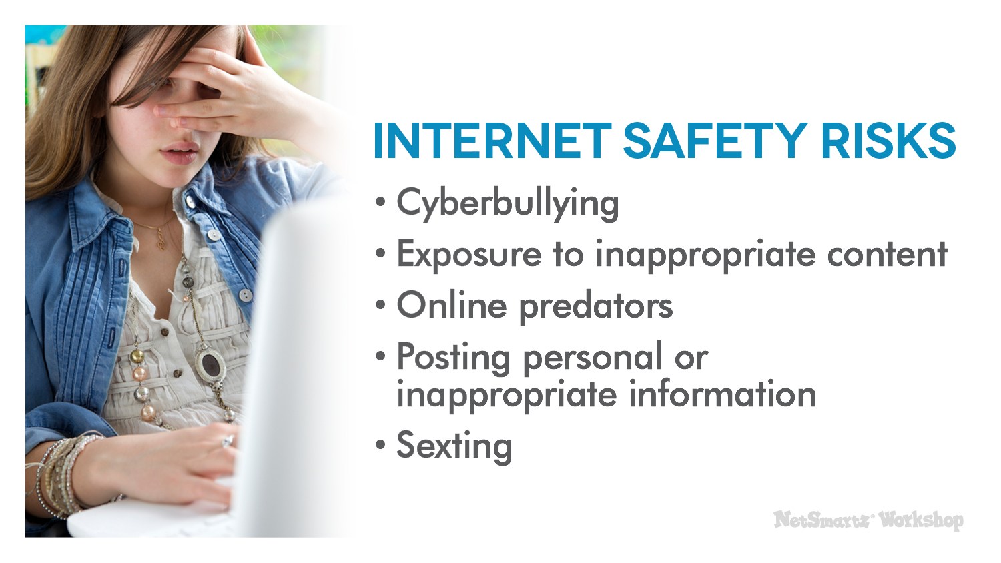
Notes:
The good news is that most children are not getting into trouble online, but there are still risks to consider. The issues we’re going to discuss today are not specific to just one device or website. No matter what your children like to do online, they face the following risks:
Cyberbullying.
Exposure to inappropriate content.
Online predators.
Posting personal or inappropriate information.
Sexting.
You might be thinking you don’t have to worry about cyberbullying because you have a younger child, or that your teenager already knows all about online predators. But don’t tune out just because you think the topic doesn’t apply to you. At some point, it will. You should be talking to your child about all of these issues, but you’ll be tailoring the message for your child’s age.

Slide 6
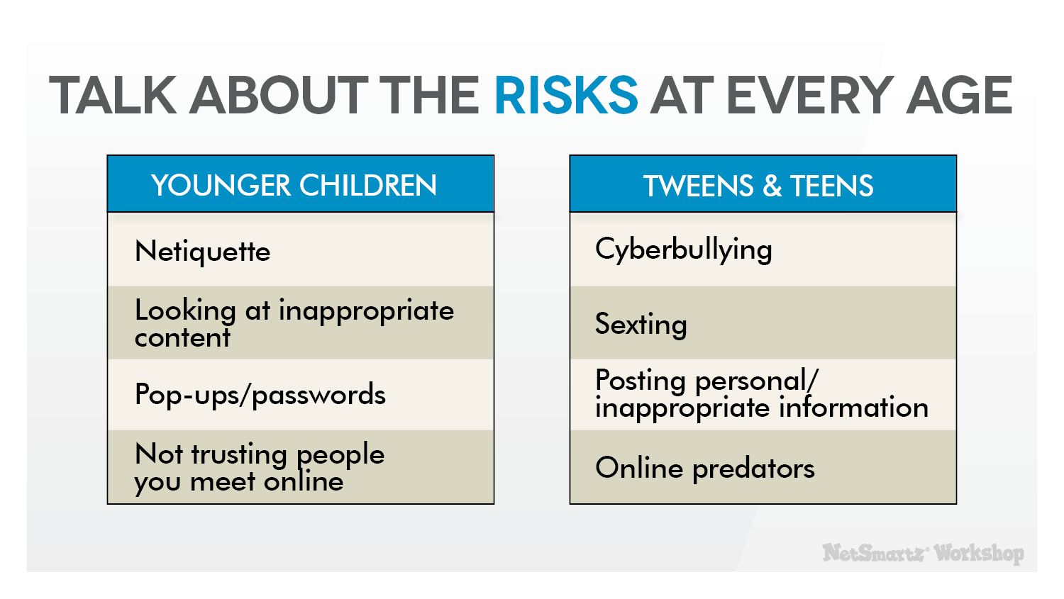
Notes:
This chart shows how you can talk to your children about all of these online risks in an age-appropriate way. For example:
You should start talking about online manners, or “netiquette,” with your youngest children so that they have a good foundation for later lessons about issues like cyberbullying.
You can start talking to your tweens about not posting revealing pictures and evolve that into a frank discussion about sexting when they become teenagers.
You can talk to young children about not trusting people they meet online. By the time they’re teens, they’ll be ready to discuss the risks of online predators.
The information you learn in this presentation will help prepare you for all of these discussions.

Slide 7

Notes:
One of the most important discussions you can have with your child is about online predators. This may be the issue you’re most worried about because it’s scary, but it’s important for you to understand the truth about predators so you know how to help your child avoid them.
Here are some common myths about predators:
They’re all old men.
They’re pedophiles.
They pretend to be younger to trick kids.
They find out where kids live and abduct them from their homes.

Slide 8
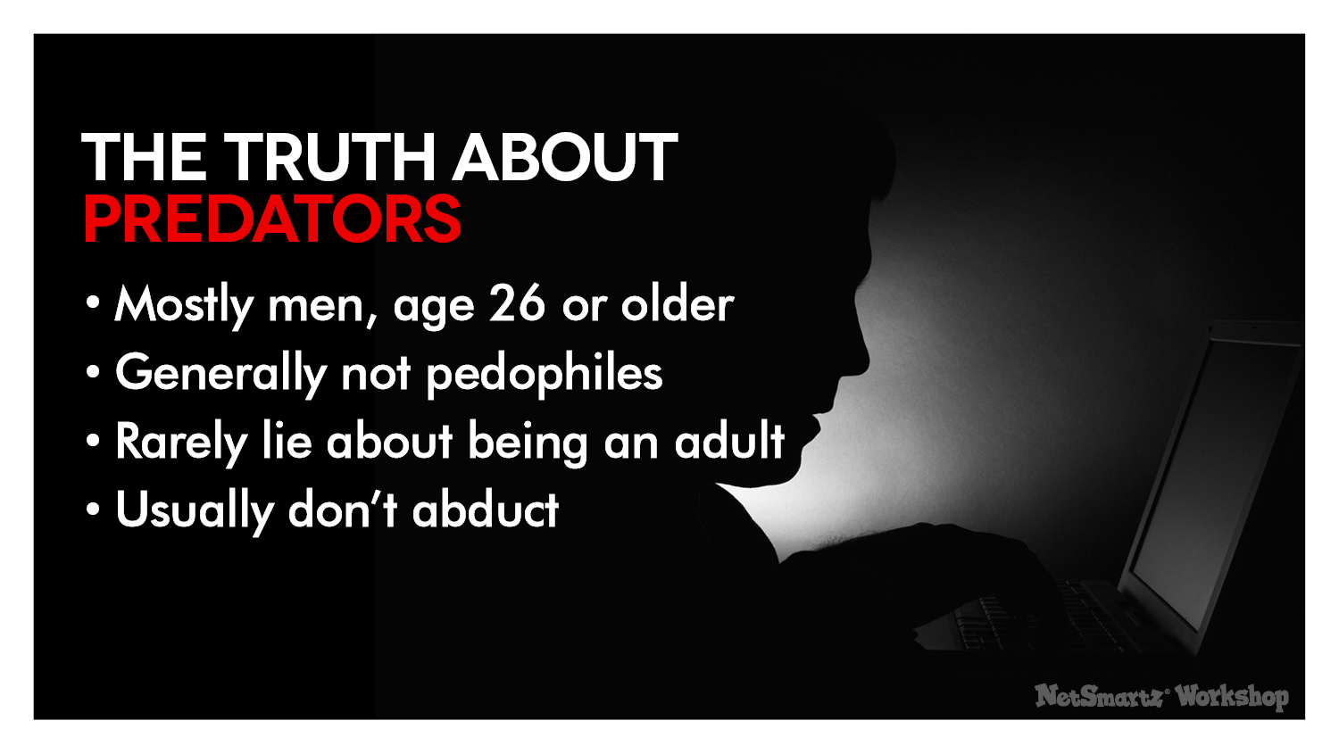
Notes:
This is who they really are:
Mostly men, age 26 or older - Studies show that 99% of predators are male. Female predators exist, but they are rare.¹
Generally not pedophiles - Pedophiles are interested in young children, but online predators typically target teens.²
Rarely lie about being an adult - Studies show that only 5% of offenders pretend to be teens.³
Usually don’t abduct - Predators and victims discuss their plans online to meet up and have sex. The teens are aware of who they’re meeting and why.⁴

Slide 9
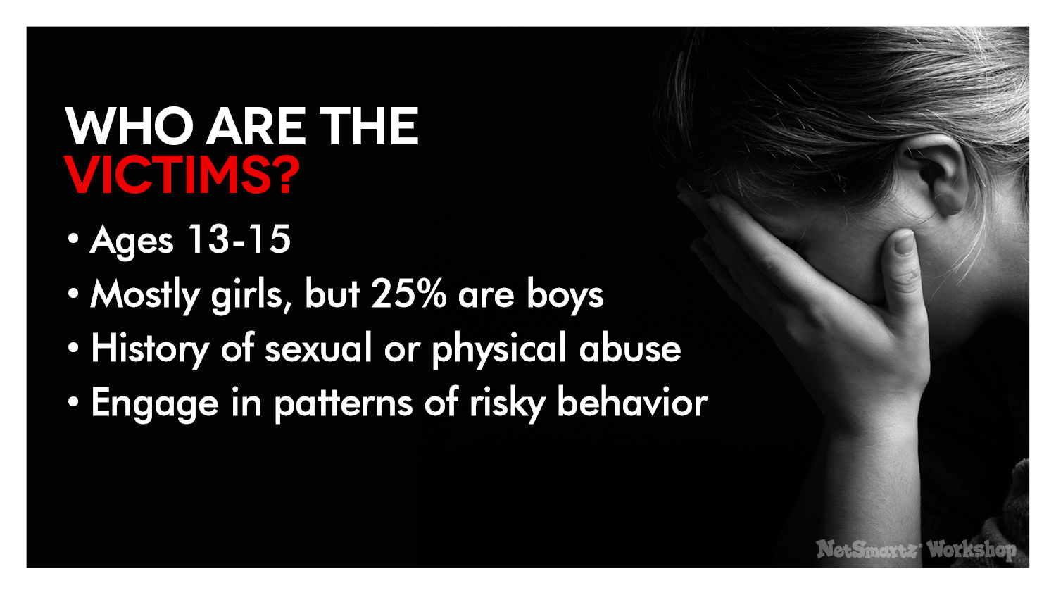
Notes:
This is what we know about the victims:
Mostly girls, but 25% of victims are boys - Boys who are gay or questioning their sexuality are particularly at risk because they are looking for affection online that they are unable to get at home or school.
Ages 13-15 - This is an especially vulnerable time for teens who are exploring their sexuality and looking for attention online.
Have a history of sexual or physical abuse - Teens with a history of abuse are more likely to seek attention online and take risks.
Engage in patterns of risky behavior - Certain behaviors make teens more vulnerable to predators, like friending unknown people online and talking to them about sex. The more risky behaviors a teen engages in online, the more at-risk they are of being targeted by a predator.⁵
The important thing to remember about victims is it’s never their fault. Predators target vulnerable teens and exploit their natural desires for attention and affection.
Examples from the News
A 13-year-old girl from PA ran away with a 20-year-old man she met online. Thanks to an anonymous tip, she was found after just 24 hours, traveling with the man on a bus to DC.⁶
A LA man was arrested after he was found in a car with two 15-year-old girls he met on the website, meetme.com. The girls told police they had sex with the man on at least four occasions.⁷

Slide 10
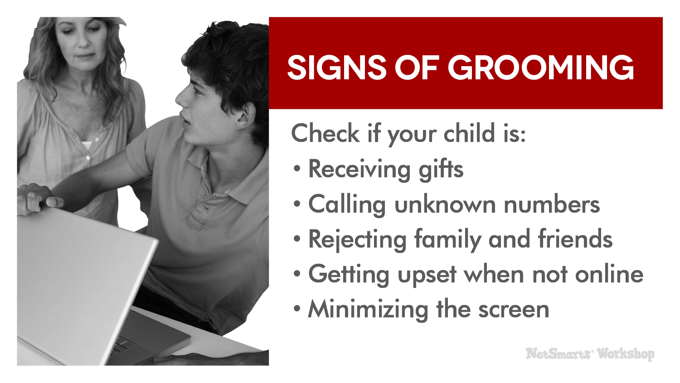
Notes:
Tom was able to manipulate Julie over a long period of time, convincing her that he was the only one she could trust. This is a process known as grooming.
Here are some signs of grooming you should look for. Check if your child is:
Receiving gifts through the mail, like bus tickets, cell phones and webcams.
Calling unknown numbers.
Rejecting family and friends in favor of spending time online.
Getting upset when he or she can’t get online.
Minimizing the screen or turning off the monitor when you come into the room .
If you see any of these signs, don’t ignore them. Talk to your children. Check out what they’re doing online and who they’re talking to. Get help immediately if you suspect something is wrong.

Slide 11
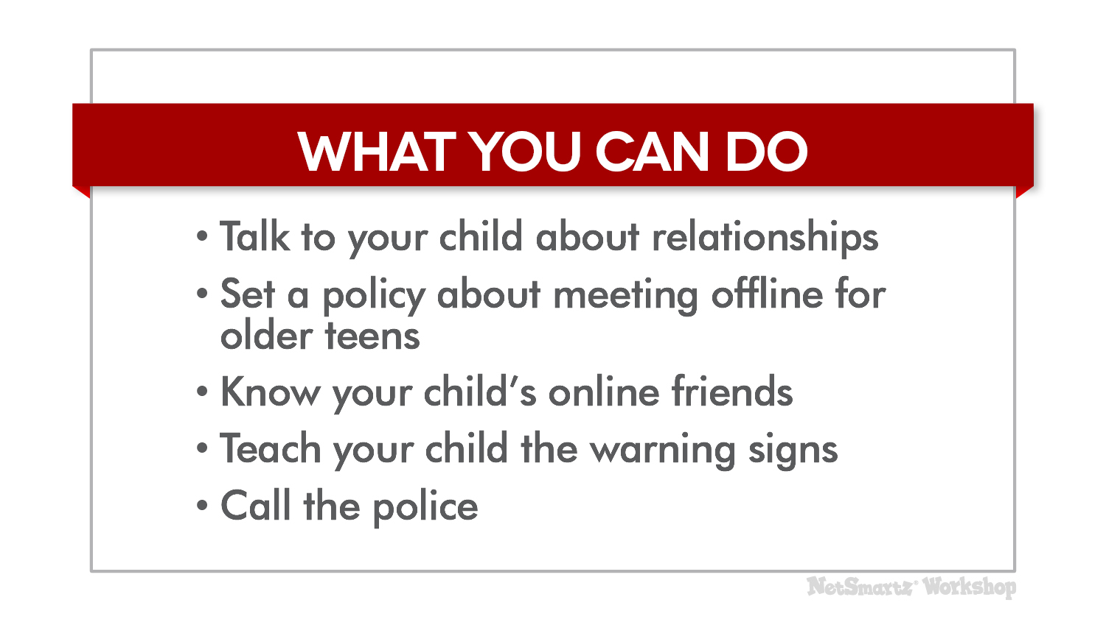
Notes:
There are several things you can do to keep your child safe from online predators:
Talk to your child about sex and relationships – Talk to them about what makes a healthy relationship. Have an open-door policy so they will not seek answers or inappropriate relationships online.
Keep in mind that many teens are flattered by attention from older people. Make it clear that a 22-year-old flirting with them is not flattering; it’s inappropriate.
This type of conversation can even start with young children. Talk to them about what is OK for people to talk about online and what is not OK.
Set a policy about meeting offline for older teens - If you think it’s okay for older teens to meet friends offline, then establish rules to make it safer. Suggested rules include:
You have to get my permission before agreeing to meet.
You have to go with me or another adult.
You must meet in a public place and not leave.
Know your child’s online friends - Encourage them not to accept friend requests from anyone they don’t already know. Ask questions about the people on their friends list, such as “How did you meet?” and “What do you talk about?”
Teach your child the warning signs - Talk to them about grooming and ways that predators try to manipulate their victims.
Above all, call the police if you suspect your child is talking to an online predator to prevent them from finding another victim.

Slide 12
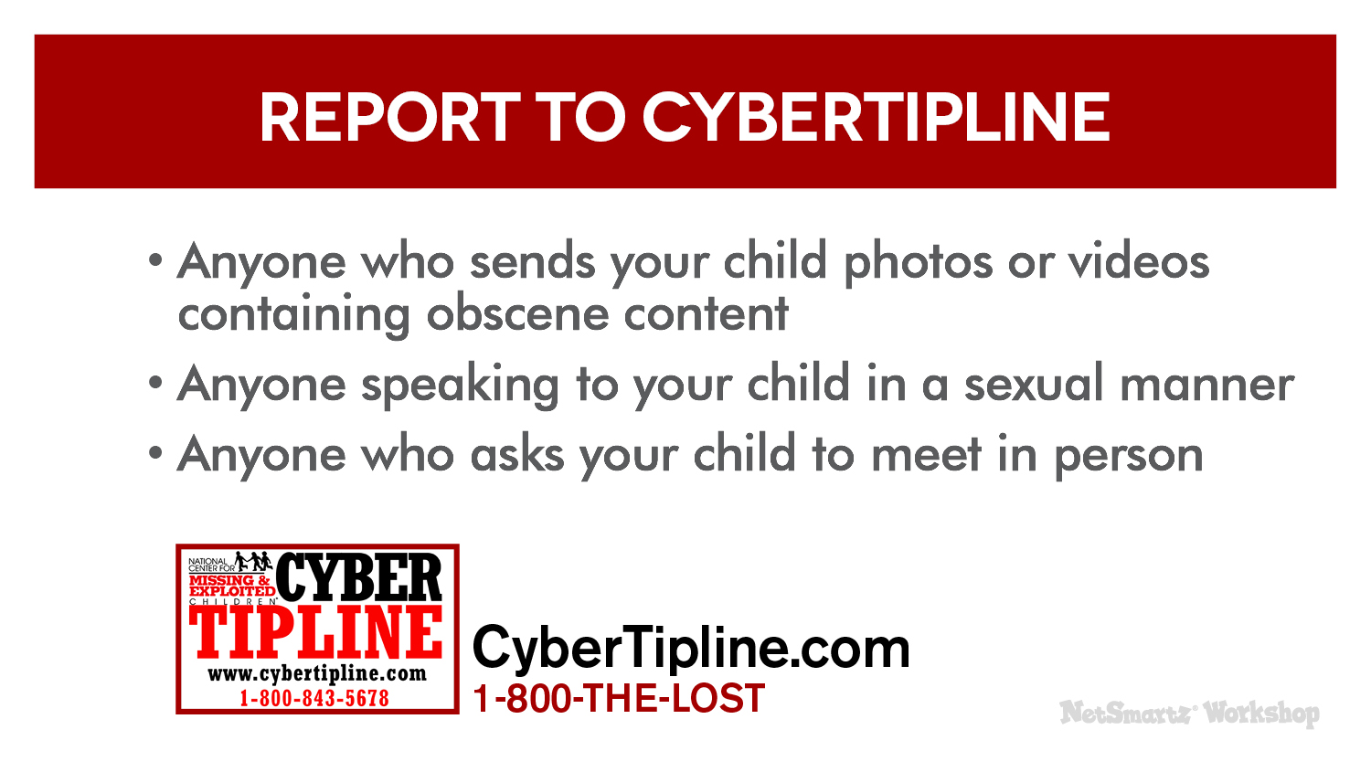
Notes:
You can also report a suspected predator to the National Center for Missing & Exploited Children’s CyberTipline®. Remember to save any messages or images your child has received and include them in your report. They will review the information that you provide and then send it to the local, state or federal law enforcement agency that can best handle your case.
Contact them if:
Anyone sends your child photos or videos containing obscene content.
Anyone speaks to your child in a sexual manner.
Anyone asks your child to meet in person.
You can contact them at www.CyberTipline.com or 1-800-THE-LOST®.

Slide 13
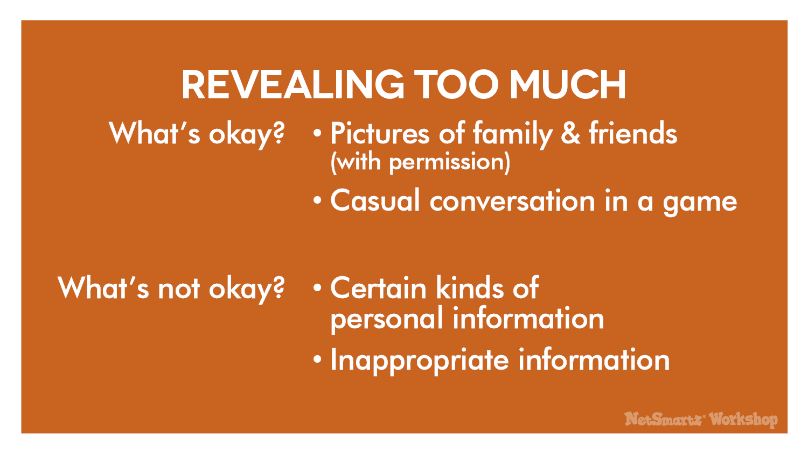
Notes:
Another thing you may be concerned about is how much information your children are sharing online. Some examples of things that are probably okay for them to share include:
Pictures of family and friends - As long as they are posted with permission, most pictures kids post are harmless. Kids love to take and post pictures as a way to express themselves and document their lives.
Casual conversation in a game - Many kids play computer games or games on a console like Xbox that allow them to talk to other players. For example, kids on Club Penguin can talk to each other, but the website uses strict chat filters and pre-selected questions and answers. Other games, like Call of Duty, allow kids to talk directly to each other on headsets. This kind of casual conversation is usually fine when kids stick to talking about the game.
There are two kinds of information you definitely don’t want your kids revealing:
Certain kinds of personal information.
Inappropriate information.

Slide 14

Notes:
Personal information that your children shouldn’t share online includes their:
Passwords.
Location (turn off GPS/location services on cell phones!).
School.
Address.
Home/cell phone number.
Sharing personal information online is a security risk because it leaves your children open to:
Identity theft - Many identity thieves target children (e.g. steal their SSN, use their name and birthdate) because you’re less likely to notice until your child is older, like when they apply for their first credit card.
Online scams - Many children, especially young children, fall for tricks like promises of money or prizes, emails that ask for passwords or other information, and links that take them to inappropriate websites.
Hacking - Sharing passwords and other account details can result in someone hacking into their accounts and pretending to be them, or stealing files and other information you store on the computer.
You might think it’s safer for your child to lie about their name and age online, but that’s not always true. For example, it’s actually against Facebook’s Terms of Service to use a fake name or age. All accounts of anyone under the age of 18 are not open to the public, so make sure they are using their real birthday. If they pretend to be older, their account has less default security restrictions.
Examples from the News
A teen in IN was using her laptop when the screen suddenly went blank and then displayed a warning from what looked like the FBI telling her she was going to go to jail if she didn’t pay up. Her parents realized it was a scam, but not before the scam artist took control of the laptop to snap a photo of the teen.⁸
One online scam lured kids onto gaming and survey websites by promising free stuff like video games. They were able to convince kids to give out their names, email addresses and other personal information.⁹

Slide 15
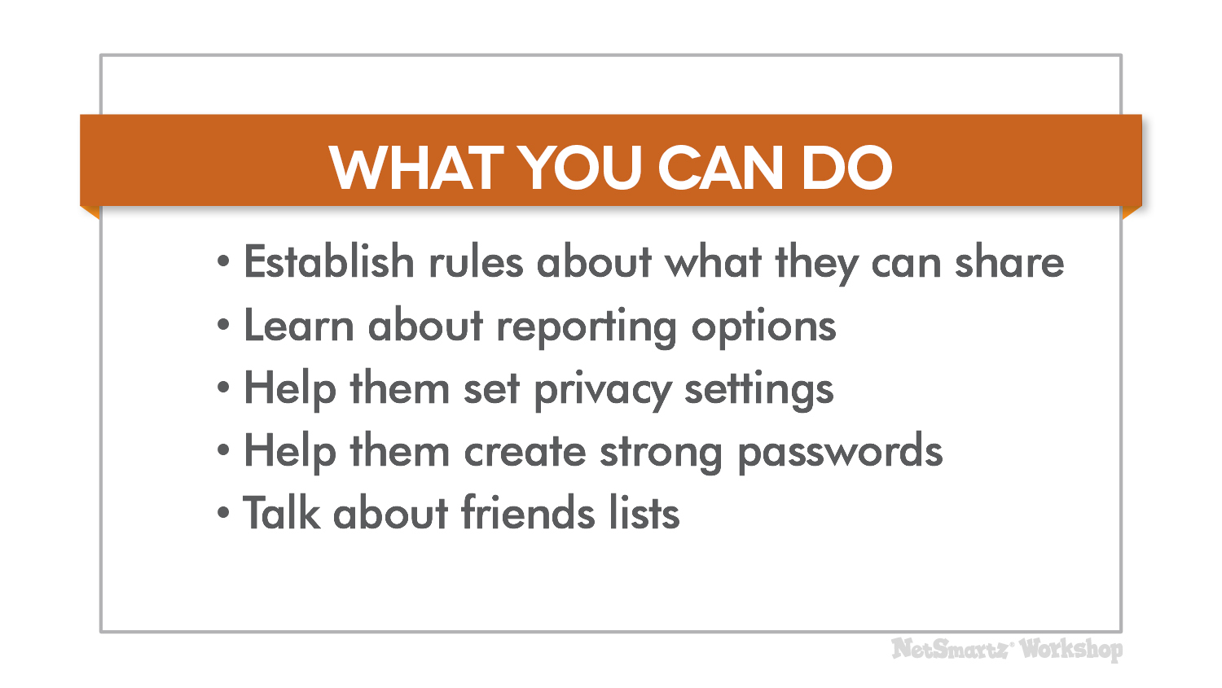
Notes:
Here’s what you can do to help your kids from revealing too much personal information online:
Establish rules about what they can share and under what circumstances - For example, it’s okay for them to enter their address online if they’re ordering something from Amazon, but it’s not okay to enter their address in a pop-up that promises to send them a prize.
Learn about the reporting options of any websites and games they’re using - Each website and game will have their own tools to report issues such as stolen passwords or hacked accounts. Get to know them so that you know what to do when there is a problem.
Check privacy settings - You should help them set up their accounts and check the privacy settings often to make sure they offer the most protection.
Help them create strong passwords and tell them not to share them with anyone but you - Passwords should be at least 8 characters long. Try using silly words or phrases that are easy to remember. Never use personal information in a password and change them often.
Talk about friends lists - NetSmartz recommends that children only add friends they know offline, but this may change as they get older. Talk to them about the types of friends you’re okay with them adding.
Suggested Resources
Parents of younger children can check out the NetSmartzKids e-book, Delivery for Webster, that teaches kids about not entering personal information into pop-ups, and the video “The Password Rap,” that helps kids create a strong password. They are both available at www.NetSmartzKids.org.
Facebook’s Family Safety Center at www.facebook.com/safety is an excellent resource for parents who have questions about protecting their children’s privacy on the site. Other sites and apps that are popular with teens, like Twitter and Instagram, also have their own safety and security pages with tips on protecting personal information.

Slide 16
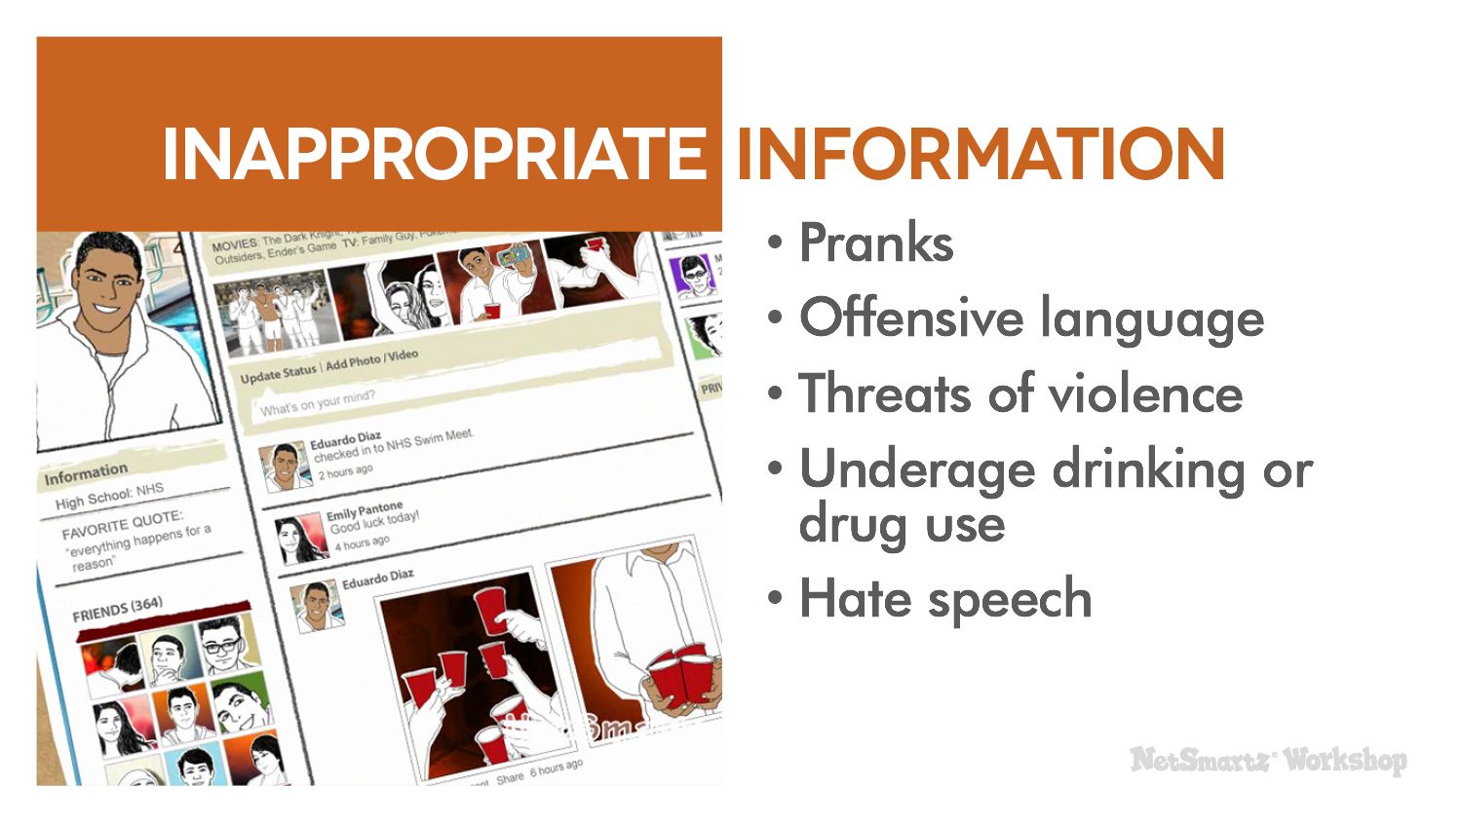
Notes:
Inappropriate information that your child shouldn’t share online includes:
Pranks (e.g. posting about a prank they pulled at school).
Offensive language.
Threats of violence.
Underage drinking or drug use.
Hate speech.
Posting these things online means your child may:
Damage their reputation at school, in the workplace or among their friends.
Be punished at school if what they post breaks school rules.
Be charged with a crime if they are breaking a law.
Hurt their chances of getting into college, getting a scholarship or getting a job in the future.
Examples from the News
A middle school student in MI was arrested after posting threatening messages on Facebook saying he was going to kill students at his old school. He was charged with felonies for threat of terrorism and using a computer to commit a crime.¹⁰
A MA high school student posted the password to his English teacher’s web portal online. He thought that kids would go in and post funny pictures, but instead anonymous posters harassed the teacher, posting vulgar, sexual comments that sent her to counseling. The student was expelled and lost his college scholarship.¹¹

Slide 17
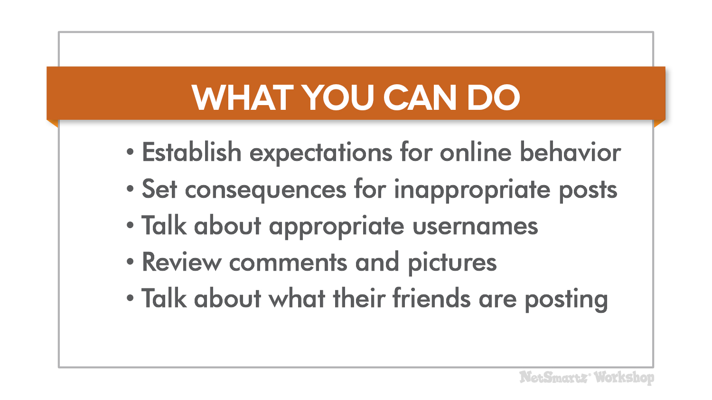
Notes:
Here’s what you can do to help prevent your child from posting inappropriate information online:
Establish expectations for online behavior – Let them know exactly what you think is unacceptable. For very young children, this might be limited to what websites they are allowed to go on and for how long, but for older children it might include what websites and apps they can use, how long they can use them, who they talk to, what they post, and more.
Set consequences for inappropriate posts - Remind them that they can also face consequences at school and with the law.
Talk about appropriate usernames - This is especially true for younger children who play in virtual worlds or any children who play games online. Usernames shouldn’t contain offensive language or violate the game’s rules.
Review comments and pictures - Check out what they’re posting and ask them to take down anything inappropriate.
Talk about what their friends are posting - Sometimes what your children’s friends post can reflect poorly on them, too, so look at their friend’s posts and discuss them if needed.

Slide 18

Notes:
How many of you have heard about cyberbullying? What do you know about it?
(Pause for audience response.)
Cyberbullying is exactly what it sounds like - bullying through technology like cell phones, social media sites and online games. Research tells us that:
About 32% of online teens ages 12-17 have been cyberbullied. ¹⁴
Girls are more likely to be targeted.¹⁵
Youth who identify as gay, lesbian, bisexual or questioning are more likely to be involved, both as a victim and a bully.¹⁶

Slide 19
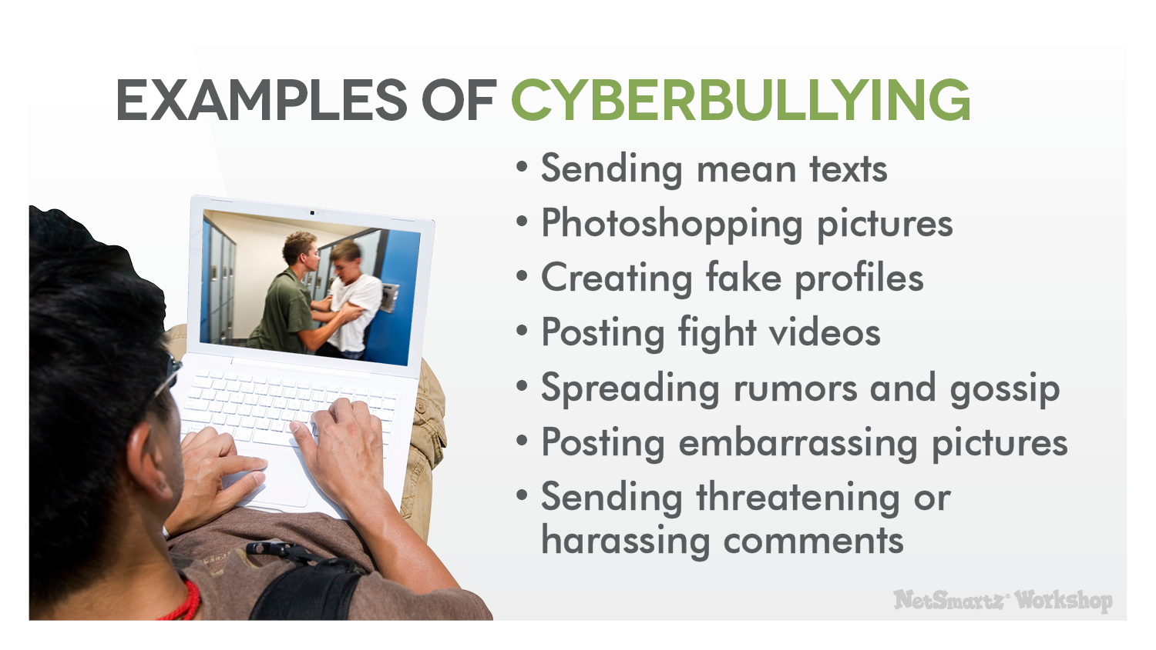
Notes:
Some examples of cyberbullying include:
Sending someone mean texts.
Photoshopping or altering a picture to embarrass someone.
Creating a fake profile to post defamatory information or images.
Posting fight videos online to embarrass the person who lost.
Spreading rumors and gossip online.
Posting an embarrassing picture of someone with intent to embarrass.
Sending threatening or harassing comments.
Even young children who don’t use social media or cell phones can experience some form of cyberbullying while playing online games or playing in a virtual world. For example, they might be:
Exposed to inappropriate language while chatting.
Taunted by other players.
Targeted by more experienced players.

Slide 20

Notes:
Cyberbullying differs from regular bullying in a number of ways. It:
Often spreads faster than in-person bullying because of instant online communication.
Has a wider audience because it can easily be sent to a potentially unlimited amount of people.
Follows children home from school so they can’t get away from it.
All of this can undermine your child’s sense of security. Cyberbullies are usually peers they know, so they don’t feel safe at school because their bully is there, but now they don’t feel safe at home either because it’s happening 24/7 online.

Slide 21

Notes:
You may have heard a lot about cyberbullying in the news because of highly-publicized teen suicides. It’s important to remember that suicide as a result of cyberbullying is extremely rare.
Researchers have looked at cases of cyberbullying-related suicide and found that:¹⁵
Most teens who committed suicide were bullied both at school and online.
Many of the teens had some type of mental illness, such as depression.
This means that although cyberbullying can be extremely devastating for victims, most teens will not commit suicide solely as a result of the cyberbullying. There are usually other factors at play.
Examples in the News
Ryan Halligan suffered from developmental delays and was bullied at school and online for years. He received homophobic messages and was the victim of a prank when a girl at school pretended to like him online, but copied and pasted their private messages to others to embarrass him. He was 13 when he committed suicide.¹⁷
Megan Meier had ADD and battled depression. She had been exchanging messages on MySpace with a boy named Josh Evans, who one day turned on her and sent mean messages. After a heated exchange online, Megan committed suicide, just three weeks before her 14th birthday. Her parents later found out that Josh Evans was never real; he was allegedly made up by Megan’s former friend and her mother.¹⁸
Jessica Logan had sexted nude pictures to her boyfriend, but he forwarded them to others when they broke up to get revenge. Jessica was taunted and harassed by girls at school. Jessica committed suicide at the age of 18.¹⁹
Jamey Rodemeyer struggled for years with his sexuality and sought counseling for constant bullying online and at school. He posted a video to YouTube for the “It Gets Better” campaign to encourage other bullied youth to hang in there. He committed suicide at age 14.²⁰
Amanda Todd was harassed for years online and at school after a picture of her flashing a stranger on a webcam chat went viral. She suffered from anxiety and depression, and engaged in self harm. Amanda posted an emotional video to YouTube detailing her harassment and bullying, then committed suicide a month later at the age of 15.²¹

Slide 22
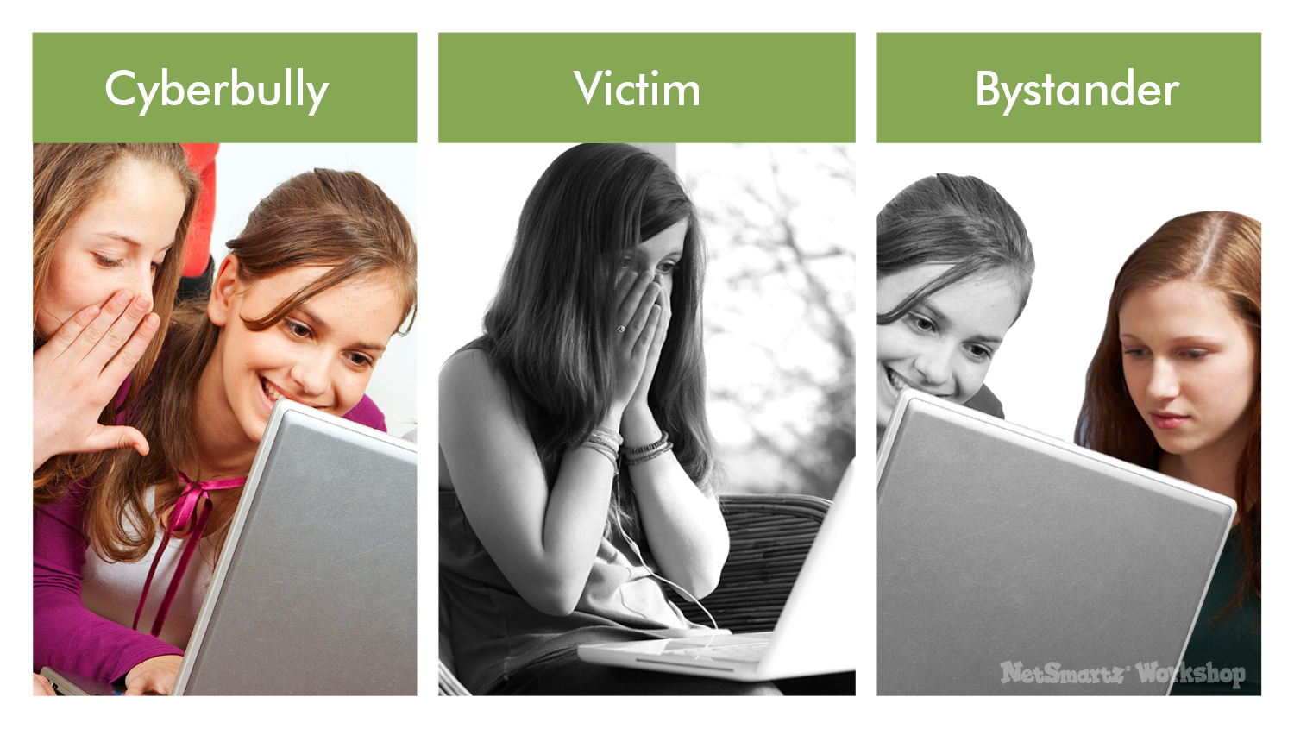
Notes:
As you can see, cyberbullying can have a tremendous impact on children. That’s why it’s so important for you to understand the issue. To combat cyberbullying, you need to know who is involved. Here are the major players:
Cyberbully - can be someone who instigates the bullying or someone who joins in.
Victim - the one being bullied, usually both online and offline.
Bystanders - those who stand by and watch the cyberbullying happen, but do nothing.
Your child likely falls in at least one of these categories, sometimes more than one because many children who are cyberbullied also cyberbully others. They have also probably been bystanders at one point or another. Let’s talk about how to address each of these categories.

Slide 23
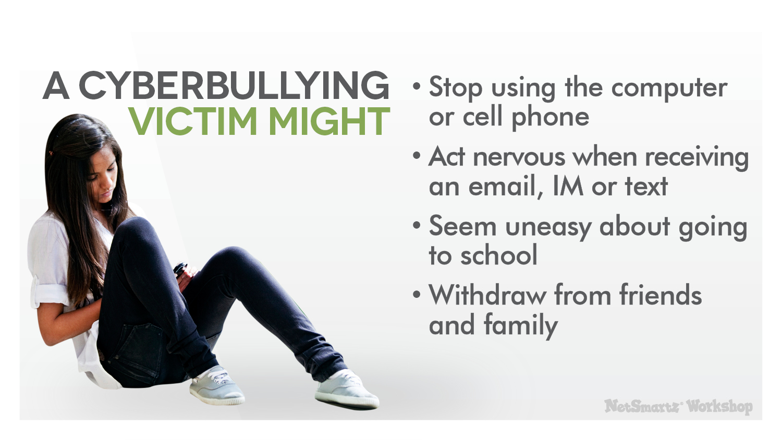
Notes:
Because cyberbullying can be so far reaching, it greatly impacts its victims. If your child is being cyberbullied, he or she may:
Suddenly stop using the computer or cell phone.
Act nervous when receiving an email, IM or text.
Seem uneasy about going to school.
Withdraw from friends and family.
If you see any of these signs, don’t ignore them. Cyberbullying victims need to feel that you are taking the problem seriously and that you are going to do everything that you can to help.

Slide 24
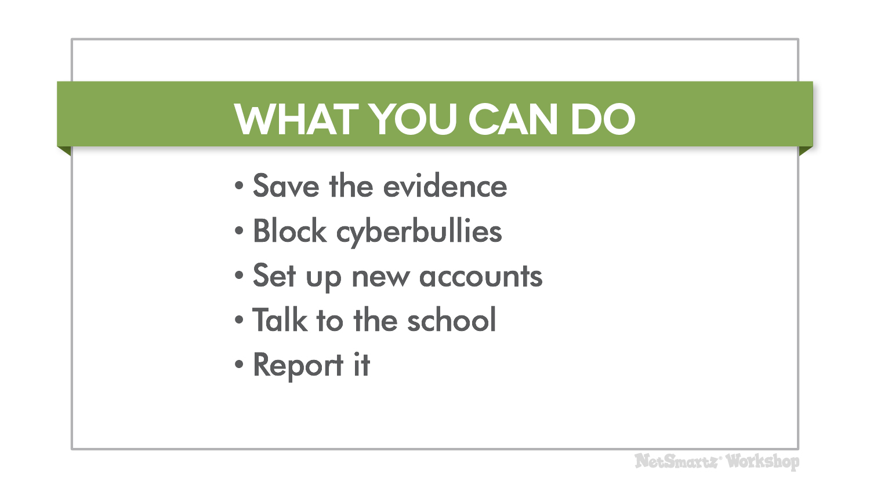
Notes:
Here are some specific ways you can help if your child is a victim of cyberbullying:
Save the evidence - Take screenshots and print out any messages. If there is an investigation, you need proof of what was posted.
Block cyberbullies – Tell your child not to respond to the messages and take advantage of website features that allow you to block any user who is bothering you.
Set up new accounts - This includes email, IM, social media sites and cell phone numbers. Make sure they only give the new information to friends they trust.
Talk to the school - Remember, most cyberbullying involves in-person bullying by someone your child knows, usually a classmate. Teachers and administrators should work together on a plan to address the bullying in school, and they may have specific rules against cyberbullying, too.
Report it to the website or app where the cyberbullying is taking place - You might also be able to report unwanted text messages to your cell phone provider and block certain numbers.
If you feel that any laws have been broken or if your child has been threatened, then contact the police for help.

Slide 25
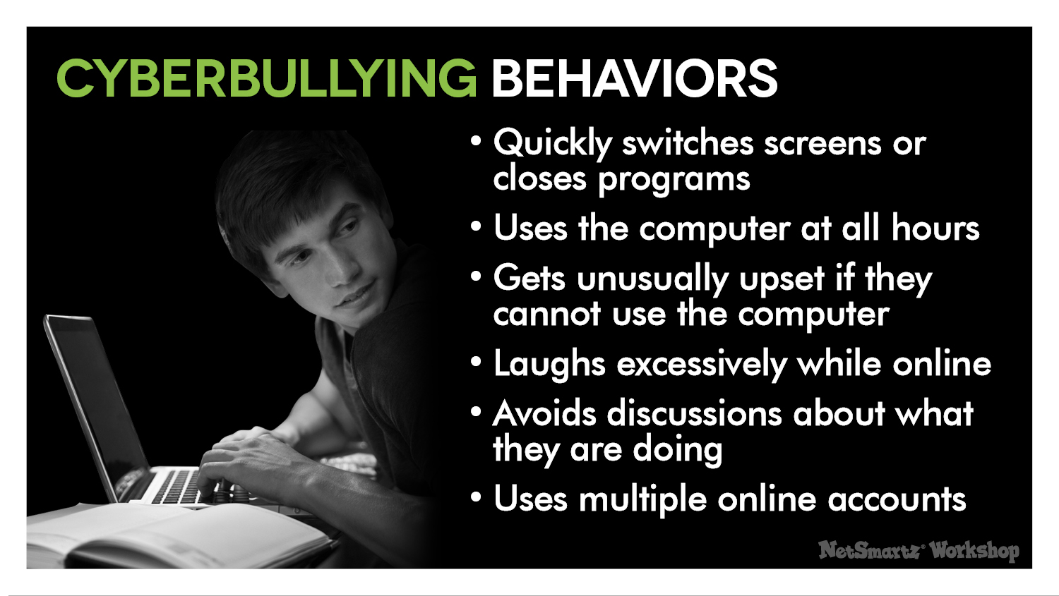
Notes:
Sometimes parents don’t find out that their children are cyberbullying others until they hear about it from another parent or from the school. Be proactive and look for these signs.
Your children may be involved with cyberbullying if they:²²
Quickly switch screens or close programs when you walk by.
Use the computer at all hours of the night.
Get unusually upset if they cannot use the computer.
Laugh excessively while online.
Avoid discussions about what they are doing.
Use multiple online accounts or use an account that is not their own .
If you notice any of these behaviors, get involved and ask them to show you what they’re doing.

Slide 26
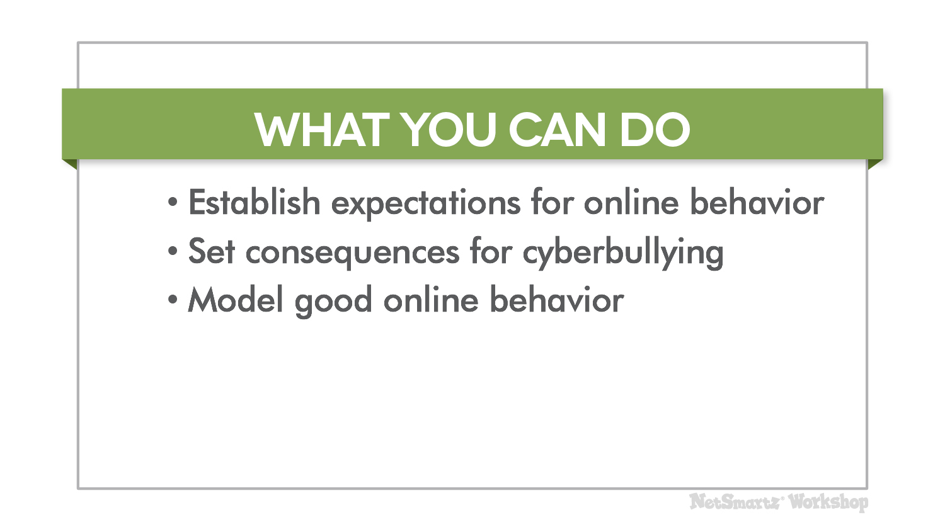
Notes:
To help prevent your child from becoming a cyberbully, you can:
Establish expectations for online behavior - Make sure your child knows that you think bullying and cyberbullying are unacceptable.
Set consequences for cyberbullying - This will vary by family, but can include losing Internet privileges or more supervised Internet use.
Model good online behavior yourself - Children learn from the adults around them, so always be respectful of others online.
You don’t have to tell your children that they have to be friends with everyone, but you should teach them about respecting others. If you find out that your child has already been involved in cyberbullying, be open to working with the school as they look to correct the problem.

Slide 27
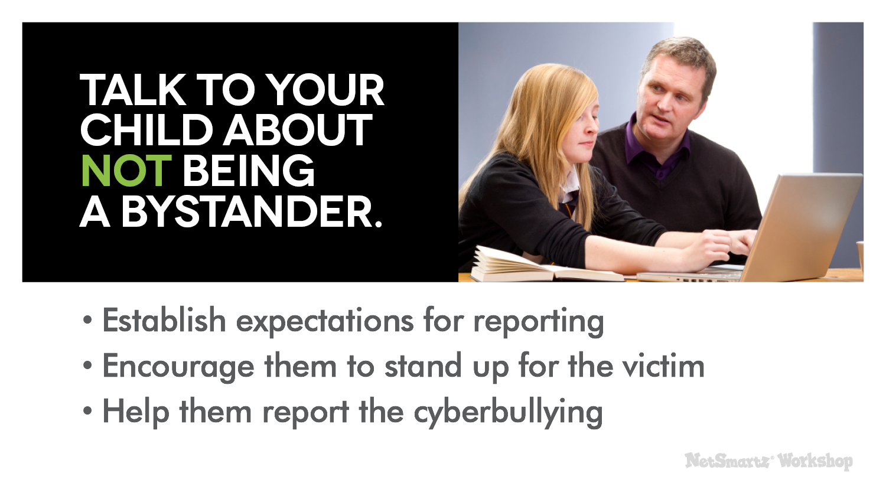
Notes:
Most kids are not bullies or victims; they are bystanders. They are afraid to speak up about cyberbullying because they’re afraid of being targeted next or being called a tattletale. However, information from bystanders is critical if teachers and other trusted adults are to take action.
Talk to your child about not being a bystander. You can do this by:
Establishing expectations for reporting - Make sure they understand that you expect them to speak up when they see cyberbullying happen because silence only lets it continue.
Encouraging them to stand up for the victim when they feel it’s safe to do so - That might mean being a good friend to the victim, telling the bully to stop or refusing to join in the cyberbullying. They can also show support to the victim in private.
Helping them report the cyberbullying to a website where the cyberbullying is taking place or to a trusted adult at school - Bystanders will feel better about reporting if they are reassured they’re doing the right thing, so help them see it through.

Slide 28

Notes:
You’ve now heard several strategies to help you deal with online predators, revealing too much personal information, posting inappropriate images and cyberbullying. Most of those suggestions have been based on communicating with your children, but I also want to talk about technological solutions.
Here are some options you may want to look into:
Filtering and monitoring software - These can help protect your children from seeing sexually explicit content online and even notify you if they’re receiving inappropriate messages. NetSmartz does not endorse any particular kind of software, but you can go to www.getnetwise.org to search for the software that best fits your needs.
Consult your cell phone provider - They may offer monitoring options for your child’s cell phone.
Research options for mobile devices – Laptops, tablets, handheld games and MP3 players may have built-in monitoring options or software for purchase.
Look at the individual apps they’re using - Many apps have the option to turn off chat features or limit who can see what your child posts within the app.
Explore built-in security features for programs and websites - These often have their own privacy or filtering services. For example, Google has a free SafeSearch option.

Slide 29

Notes:
But remember, the most important thing is to communicate with your children about what they’re doing online. Start the conversation by asking about their interests.
Ask them questions like:
What’s your favorite app?
Who do you talk to when you play games?
What kinds of pictures do you like to post?
Discuss these things with them regularly so they know you’re available and have an open mind. Kids need to know that you won’t freak out and pull the plug if something happens online. You may not be able to protect them from everything, but you can teach them how to make responsible choices when they encounter a problem.

Slide 30

Notes:
NetSmartz is here to help you as you establish this open relationship with your child. On NetSmartz.org you’ll find resources for all ages, including:
Activities.
Discussion Starters.
Games.
Information about the issues.
Safety Pledges.
Tip Sheets.
Videos.
These resources are all age appropriate. You’ve seen some of the teen videos today, but NetSmartz also has materials specifically for tweens and younger children.
Tell others in your community about these resources. Encourage your PTA to set up presentations. You can even talk to your child’s school about using other NetSmartz teaching materials. When everybody works to confront these issues, your children become safer and are more prepared to protect themselves online.

Slide 31

Notes:
Thank you!
(End of presentation.)

Slide 32
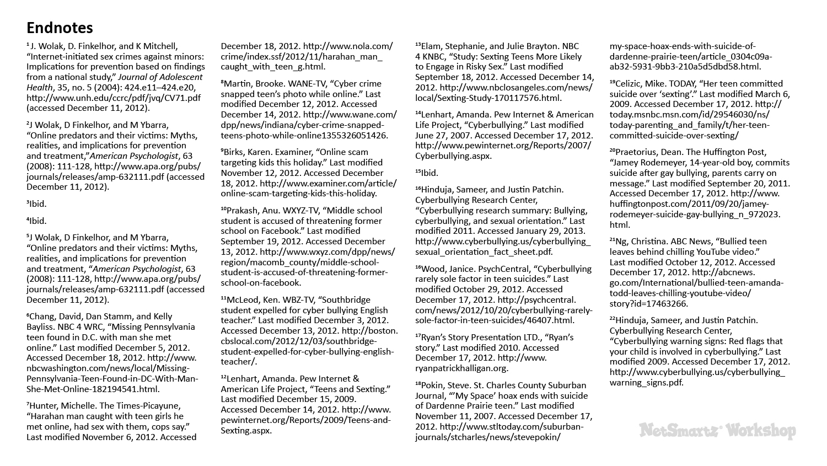

Slide 33
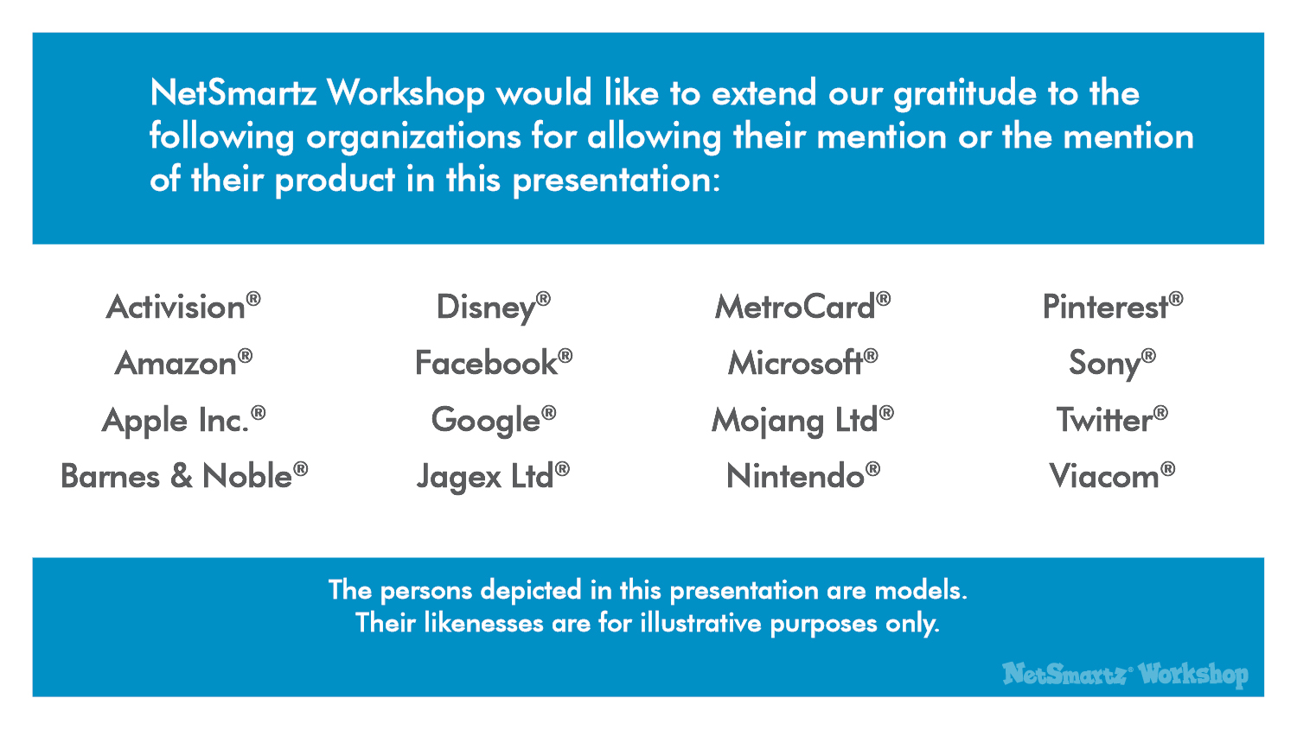

Slide 34


